Slide 1
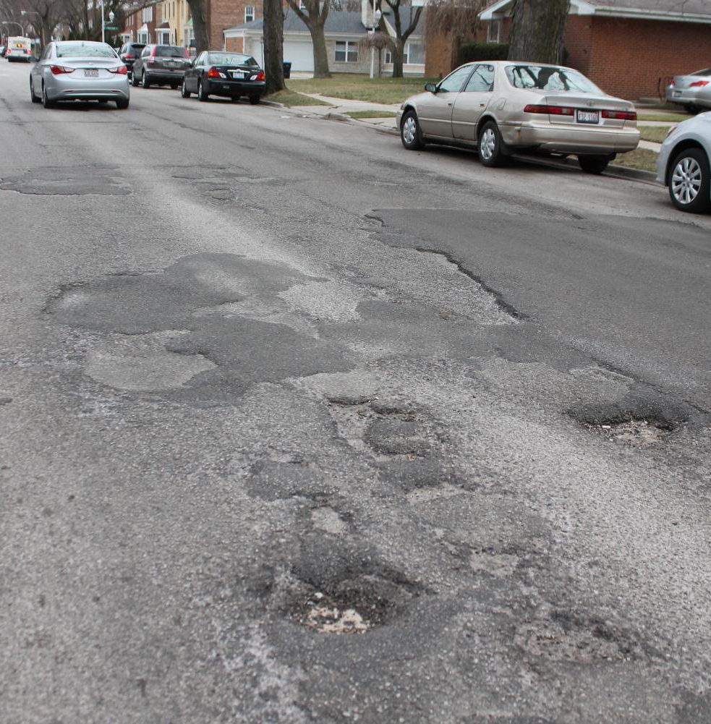
Chicago Pothole Data Presentation By: Eric Meyer, Michelle Simek and Kristen Scaletta

Slide 2

Project Inspiration and Theme
Notes:
Michelle to share pothole story—led us to be interested in locations of potholes and status over time in Chicago.

Slide 3
The Story Our Visualization Tells
For those interested in Chicago pothole data over various years, they can use this dashboard to see locations of potholes via an interactive map, completion status via a pie chart, and potholes reported by month via a line chart.
Notes:
Eric to present

Slide 4
Coding Approach and Data Munging Techniques

Slide 5
Data Cleaning
Ensured no duplicates and conformed data to standard that would work with various charts.
Notes:
Eric to present

Slide 6
Webpage and Chart Creation
Created interactive webpage with a dropdown to select year
Three charts:
Map of potholes using leaflet
Line chart of potholes by month using Plotly
Pie chart of pothole completion status using Google Charts

Slide 7
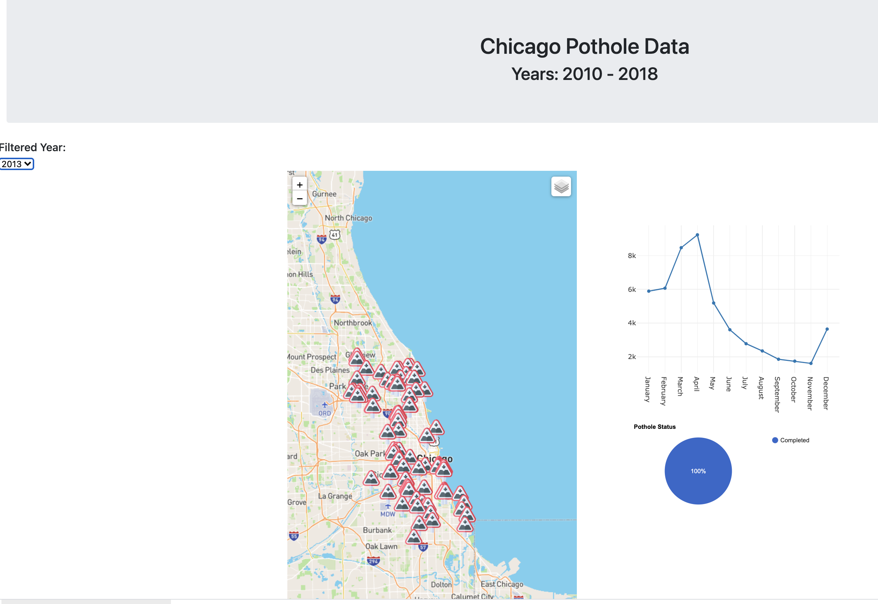
Webpage
Notes:
In each, discuss any data challenges and how we solved them (like issues with the dropdown/getting the right month stats on the line graph, etc.)

Slide 8
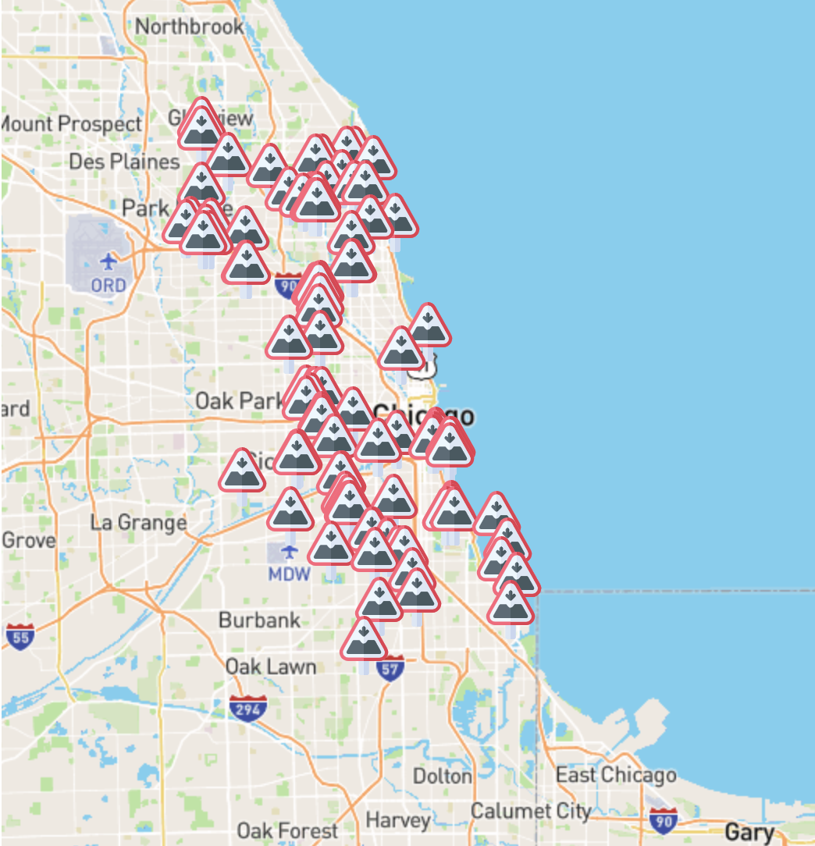
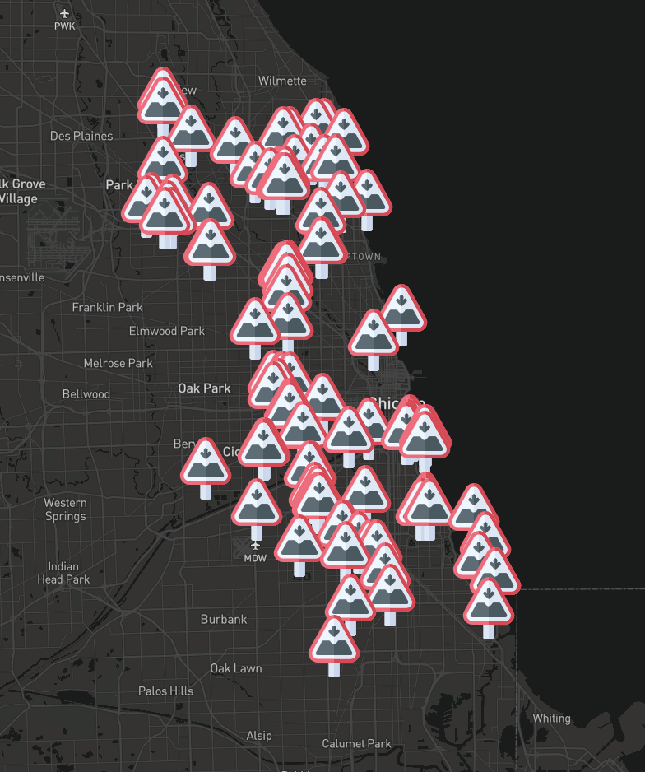
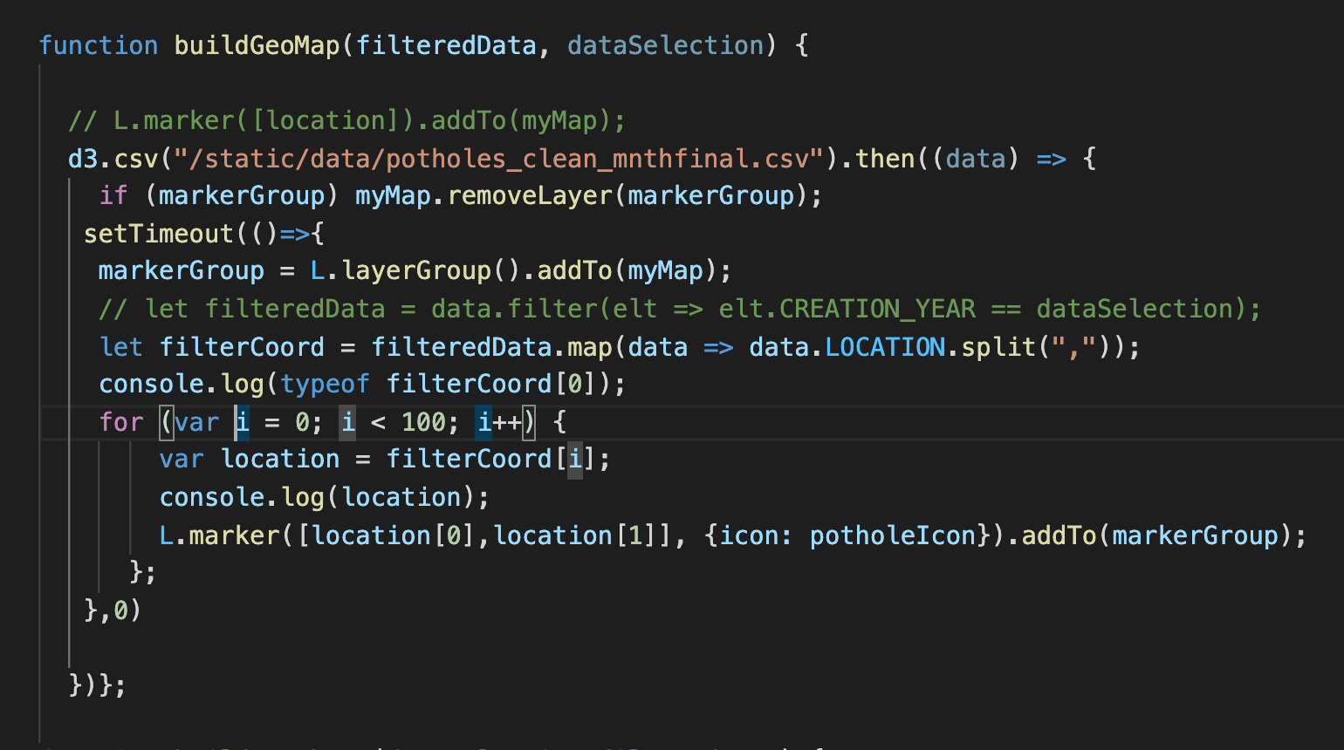
Pothole Map

Slide 9
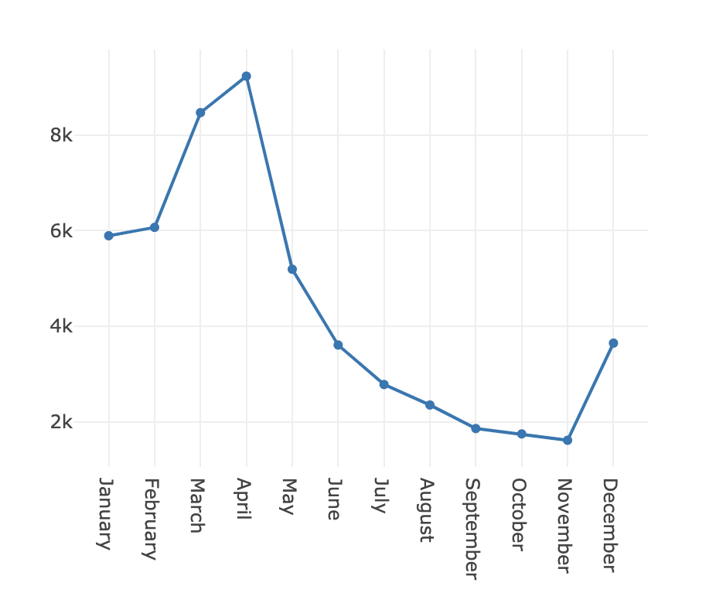
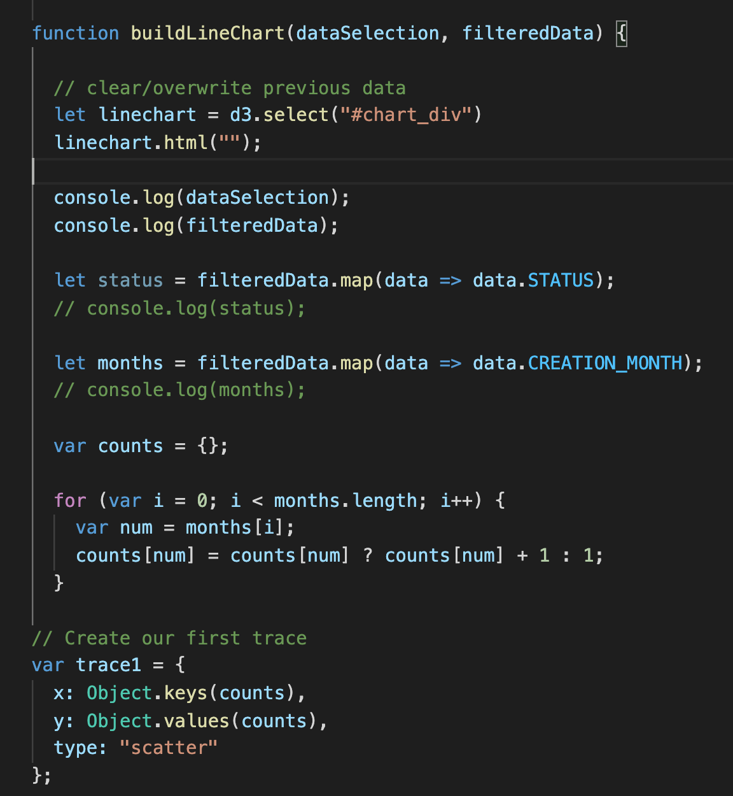
Line Chart

Slide 10
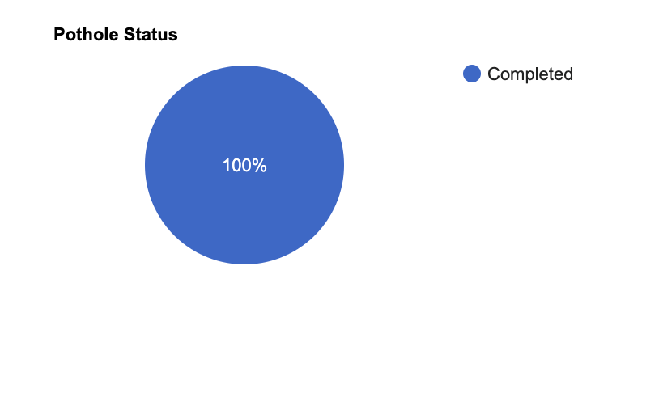
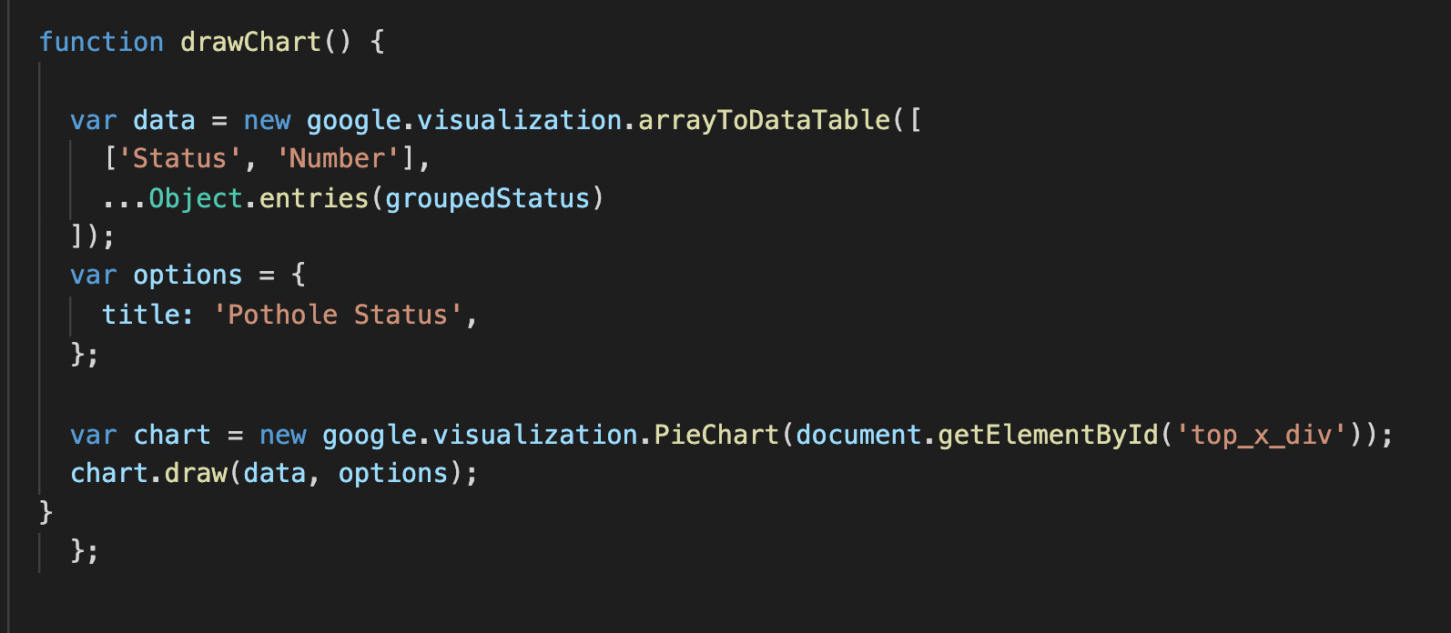
Pie Chart

Slide 11
Final Visualization

Slide 12
Here—add screenshot of final webpage but try to show live page first with interactivity. This will be backup.

Slide 13
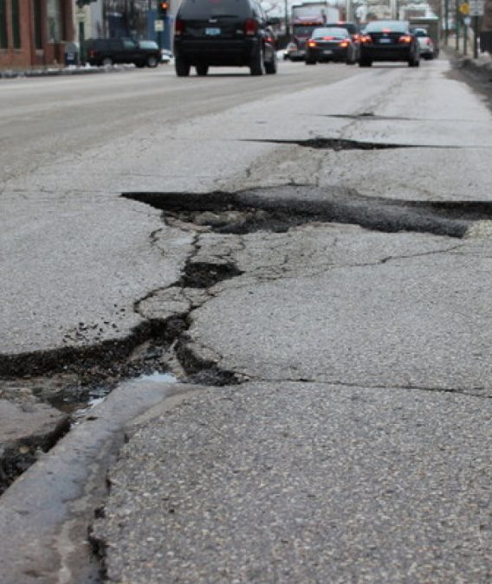
Questions?

